Slide 1



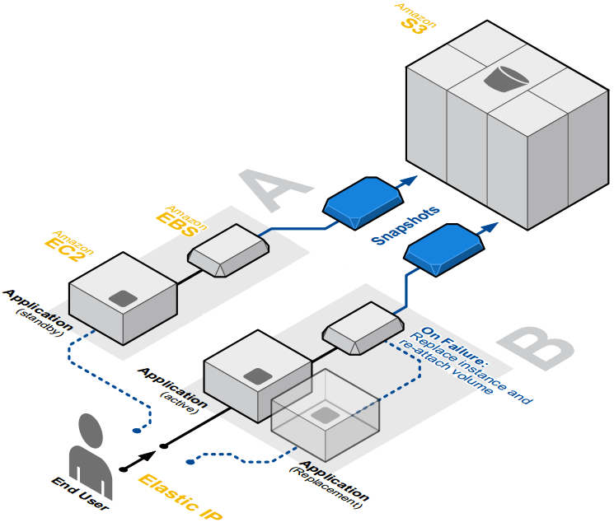
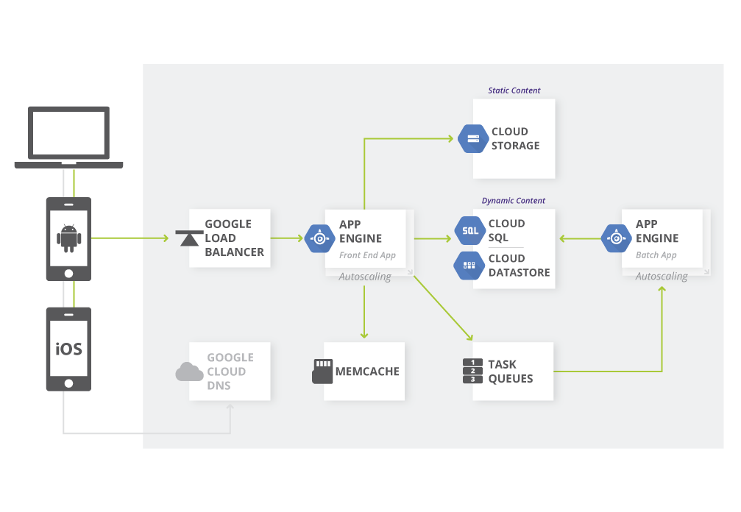
Fault-Tolerant Cloud Computing Architectures A comparative study
Authors: Andreas Kjeldsen (s092638), Morten Eskesen (s133334)
Architecture
Many services offered. Services have different functions.
Some services are fault-tolerant by design and can be connected to
Other services, thereby making a complete fault-tolerant system.
Tekst her
Example of fault-tolerant application architecture hosted on AWS
Google Web Application Architecture on Google App Engine
Redundant storage
Four different storage services: Simple Storage Service (S3),
Elastic Block Storage (EBS), Databases (RDS, DynamoDB & SimpleDB),
EC2 instances with SSDs.
S3 is highly available and redundant storage. EBS and the databases have
replication and can be backed up to S3. The SSDs on the EC2 instances
should push data to persist to EBS.
Tekst her
Availability
Multiple regions available throughout the world.
Each region has multiple availability zones.
Resources are replicated to various availability zones.
Tekst her
Load balancing
Distributes load between multiple computing instances.
Can automatically detect failed computing instances and make sure
traffic is only routed to running computing instances.
Tekst her
DTU Compute
DTU Compute
Notes:
Tekst og Streger i 100% farve – Baggrund i 90% Transparent.

Slide 2
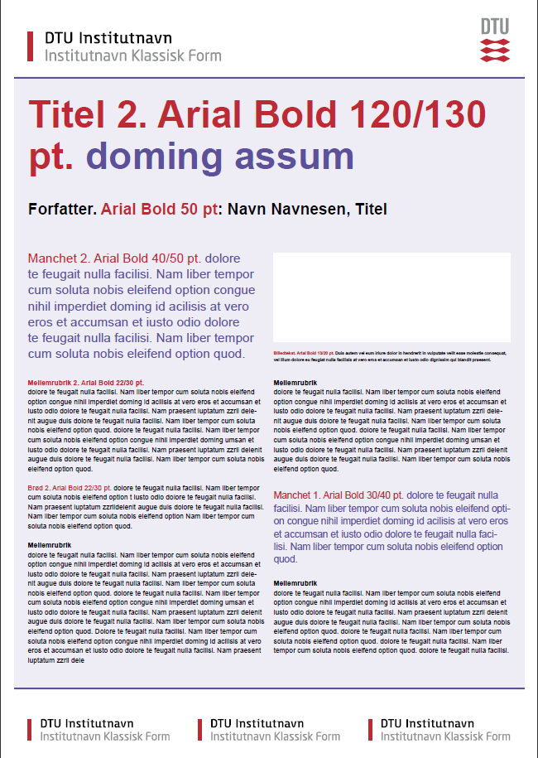

Titel Arial Bold 1. 90/110pt, 2. 120/130pt, 3. 145/155pt. )
Forfatter: Navn, Titel (Arial Bold 50pt)
Manchet (Arial Bold 1. 30/40pt. el.
2. 40/50pt)
Mellemrubrik (Arial Bold 1. 18/24pt. el. 2. 22/30pt.)
Brødtekst (Arial 1. 18/24pt. el. 2. 22/30pt.)
Indsæt billede<
Billedtekst (Arial Regular 13/20Pt.)
Mellemrubrik (Arial Bold 1. 18/24pt. el. 2. 22/30pt.)
Brødtekst (Arial 1. 18/24pt. el. 2. 22/30pt.)
Manchet (Arial Bold 1. 30/40pt. el.
2. 40/50pt)
Mellemrubrik (Arial Bold 1. 18/24pt. el. 2. 22/30pt.)
Brødtekst (Arial 1. 18/24pt. el. 2. 22/30pt.)

Slide 3
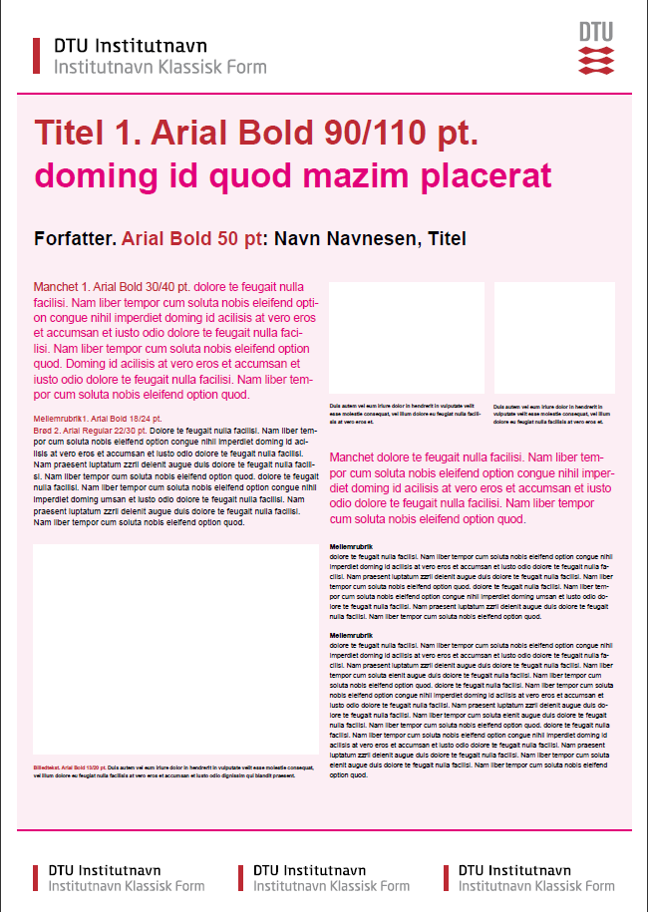
Titel Arial Bold 1. 90/110pt, 2. 120/130pt, 3. 145/155pt. )
Forfatter: Navn, Titel (Arial Bold 50pt)
Manchet (Arial Bold 1. 30/40pt. el.
2. 40/50pt)
Mellemrubrik (Arial Bold 1. 18/24pt. el. 2. 22/30pt.)
Brødtekst (Arial 1. 18/24pt. el. 2. 22/30pt.)
Indsæt billede<
Indsæt billede<
Billedtekst (Arial Regular 13/20Pt.)
Billedtekst (Arial Regular 13/20Pt.)
Manchet (Arial Bold 1. 30/40pt. el.
2. 40/50pt)
Mellemrubrik (Arial Bold 1. 18/24pt. el. 2. 22/30pt.)
Brødtekst (Arial 1. 18/24pt. el. 2. 22/30pt.)
Indsæt billede<
Billedtekst (Arial Regular 13/20Pt.)

Slide 4
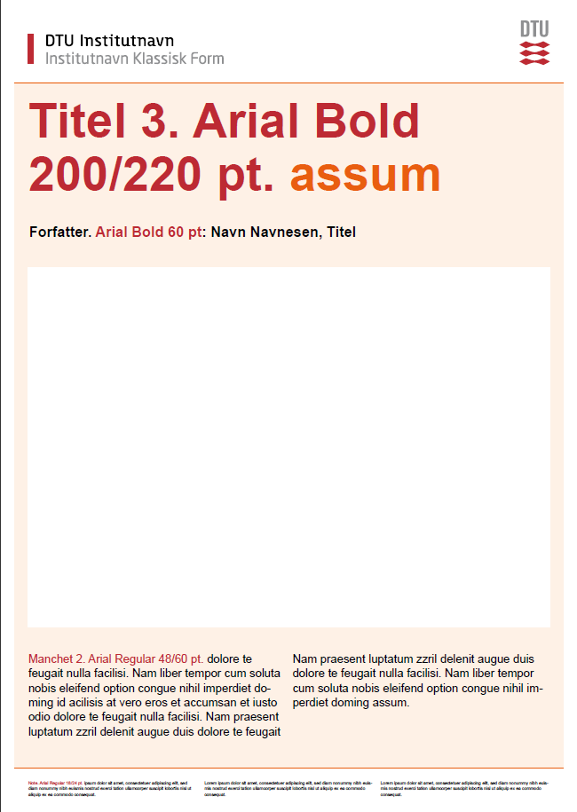
Titel Arial Bold 1. 90/110pt, 2. 120/130pt, 3. 145/155pt. )
Forfatter: Navn, Titel (Arial Bold 50pt)
Indsæt billede
Manchet (Arial Bold 1. 35/45pt. el. 2. 48/60pt)
Manchet (Arial Bold 1. 35/45pt. el. 2. 48/60pt)
Note eller Institutnavn (Arial Regular 14/18pt.)
Note eller Institutnavn (Arial Regular 14/18pt.)

